Slide 1
Compiler Design - Mini Project
Infix to Postfix conversion
B1000109117
RA1911003010109
RA1911003010117

Slide 2
Agenda
In the analysis-synthesis model of a compiler, the front end of a compiler translates a source program into an independent intermediate code, then the back end of the compiler uses this intermediate code to generate the target code (which can be understood by the machine).
There are several benefits of using machine independent intermediate code.
Postfix is one such intermediate code representation
Infix expressions are readable and solvable by humans.
We can easily distinguish the order of operators, and also can use the parenthesis to solve that part first during solving mathematical expressions.
The computer cannot differentiate the operators and parenthesis easily, that’s why postfix conversion is needed.

Slide 3
Abstract
Infix expressions are readable and solvable by humans.
We can easily distinguish the order of operators, and also can use the parenthesis to solve that part first during solving mathematical expressions.
The computer cannot differentiate the operators and parenthesis easily, that’s why postfix conversion is needed.
Postfix notation is the useful form of intermediate code if the given language is expressions.
Postfix notation is also called 'suffix notation' and 'reverse polish'.
Postfix notation is a linear representation of a syntax tree.
In the postfix notation, any expression can be written unambiguously without parentheses.
The ordinary (infix) way of writing the sum of x and y is with operator in the middle: x * y. But in the postfix notation, we place the operator at the right end as xy *.

Slide 4
Introduction
Infix expression: The expression of the form a op b. When an operator is in-between every pair of operands.
Postfix expression: The expression of the form a b op. When an operator is followed for every pair of operands.
Why postfix representation of the expression?
The compiler scans the expression either from left to right or from right to left.
Consider the below expression: a op1 b op2 c op3 d
If op1 = +, op2 = *, op3 = +
The compiler first scans the expression to evaluate the expression b * c, then again scans the expression to add a to it. The result is then added to d after another scan.
The repeated scanning makes it very in-efficient. It is better to convert the expression to postfix(or prefix) form before evaluation.
The corresponding expression in postfix form is abc*+d+. The postfix expressions can be evaluated easily using a stack.

Slide 5
Objective
As the operators are binary (we are not talking about unary operators here), so two operands are needed for each operator.
The nature of these operators is not affected in the postfix form i.e. the plus operator (+) will apply on two operands.
Each time we read an operand, we will push it on the stack.
We are going to evaluate the postfix expression with the help of stack.
After reaching an operator, we pop the two operands from the top of the stack, apply the operator and push the result back on the stack.

Slide 6
Module Description - 1
Algorithm
1. Scan the infix expression from left to right.
2. If the scanned character is an operand, output it.
3. Else,
1 If the precedence and associativity of the scanned operator is greater than the precedence and associativity of the operator in the stack(or the stack is empty or the stack contains a ‘(‘ ), push it.
2 ‘^’ operator is right associative and other operators like ‘+’,’-‘,’*’ and ‘/’ are left associative. Check especially for a condition when both top of the operator stack and scanned operator are ‘^’. In this condition the precedence of scanned operator is higher due to it’s right associativity. So it will be pushed in the operator stack. In all the other cases when the top of operator stack is same as scanned operator we will pop the operator from the stack because of left associativity due to which the scanned operator has less precedence.

Slide 7
Module Description - 2
Algorithm contd.
3 Else, Pop all the operators from the stack which are greater than or equal to in precedence than that of the scanned operator. After doing that Push the scanned operator to the stack. (If you encounter parenthesis while popping then stop there and push the scanned operator in the stack.)
4. If the scanned character is an ‘(‘, push it to the stack.
5. If the scanned character is an ‘)’, pop the stack and output it until a ‘(‘ is encountered, and discard both the parenthesis.
6. Repeat steps 2-6 until infix expression is scanned.
7. Print the output
8. Pop and output from the stack until it is not empty.

Slide 8
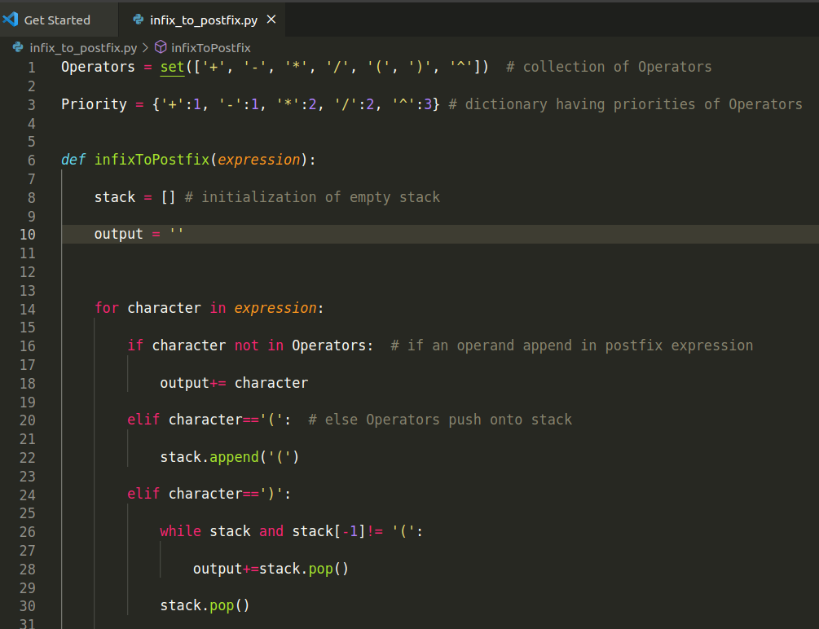
Module Description - 3
Code

Slide 9
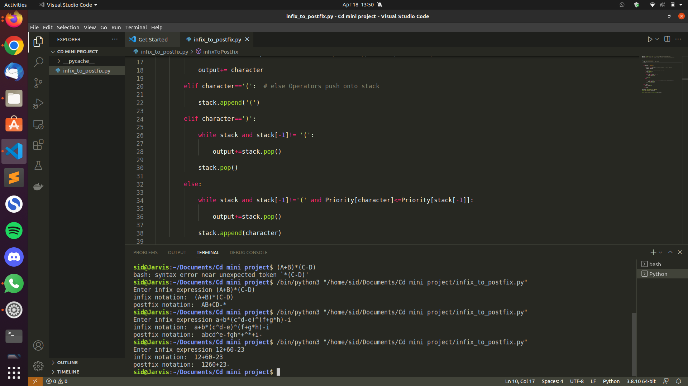
Module Description - 4

Slide 10
Conclusion
Infix expressions are what we humans use to solve problems normally. However, computers require a stack to solve expressions.I also learned why intermediate codes are important when designing a compiler. In this project, I studied a detailed view of infix and postfix notation along with the simplest technique to convert infix to postfix notation using the stack data structure.

Slide 11
References
https://www.geeksforgeeks.org/stack-set-2-infix-to-postfix/
https://www.javatpoint.com/postfix-notation
http://web.cecs.pdx.edu/~harry/compilers/slides/IntroPart2.pdf

Slide 12

Thanks!

